Slide 1
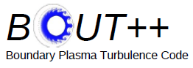



用BOUT++模拟边界局域模的形成
夏天阳^{1,2}, 徐学桥², Ben Dudson³, Bjorn Sjogreen ², 李建刚¹
¹Institute of Plasma Physics, Chinese Academy of Sciences, Hefei, China.
²Lawrence Livermore National Laboratory, Livermore, CA 94550, USA
³University of York, Heslington, York YO10 5DD, United Kindom
中科院合肥分院 等离子体所
2011年1月9日
This work was performed under the auspices of the U.S. Department of Energy by Lawrence Livermore National Security, LLC, Lawrence Livermore National Laboratory under Contract DE-AC52-07NA27344, and is supported by the China Natural Science Foundation under Contract No.10721505.
Notes:
1

Slide 2


Outline
Background
4-field peeling-ballooning simulation with BOUT++
5-field simulation
Linear simulation on EAST
Comparison of numerical schemes in BOUT++
Summary

Slide 3
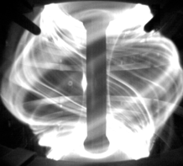
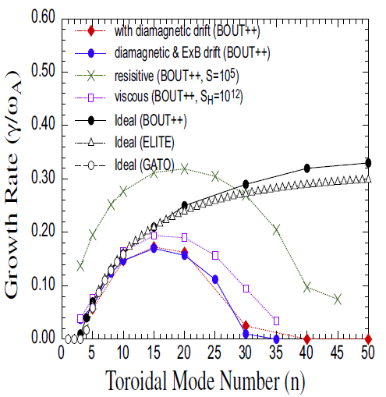
Background
In H-mode, the localized edge modes (ELMs) is a dangerous perturbation for large tokamaks, such as ITER. ELMs are triggered by ideal MHD instabilities. The type I ELM is successfully explained by ideal peeling-ballooning (P-B) theory in pedestal, in which the steep pressure gradients drive ballooning mode and bootstrap current generates peeling mode.
ELMs in MAST
BOUT++ simulates the Peeling-Ballooning modes through two fluid framework, which could study the nonlinear dynamics of ELMs including extensions beyond MHD physics.
*
*Xu, X., et al., Nucl. Fusion 51 103040 (2011)

Slide 4
Structure of BOUT++
数据结构：2D，3D场量；2D，3D矢量
格点，几何位形
偏微分方程组求解器(SUNDIAL)
代数算符
差分算符
物理模型

Slide 5
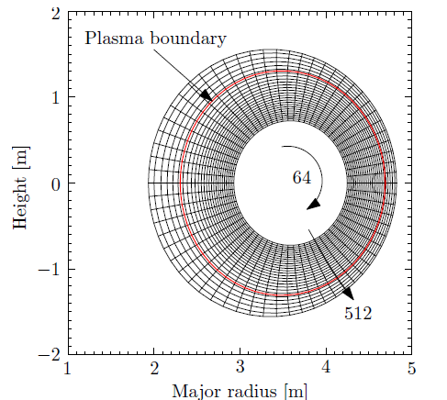
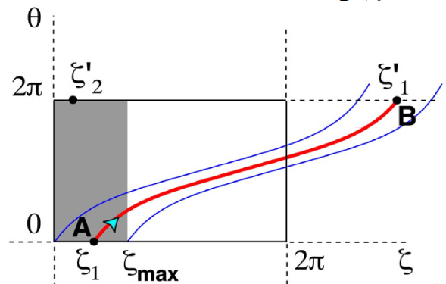
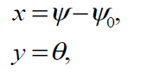
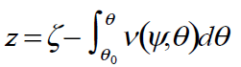
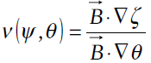
Geometry of BOUT++
All the simulations for these work are based on the shift circular cross-section toroidal equilibria (cbm18_dan8) generated by TOQ codes*. The equilibrium pressure is the same for all cases.
JET-like aspect ratio
Highly unstable to ballooning modes ( γ~0.2ω_{A})
Widely used by NIMROD, M3D-c1
θ
ψ
Field aligned coordinate applied in BOUT++:
* Miller R.L. and Dam J.W.V. Nucl. Fusion 27 2101 (1987).

Slide 6
Outline
Background
4-field peeling-ballooning simulation with BOUT++
5-field simulation
Linear simulation on EAST
Comparison of numerical schemes in BOUT++
Summary

Slide 7
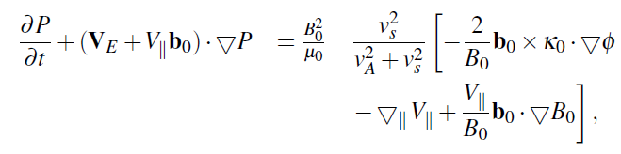
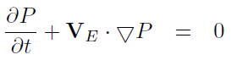
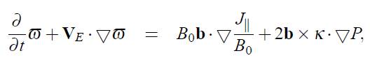
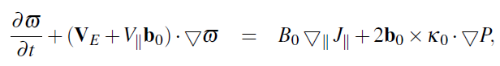
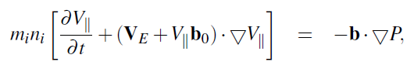
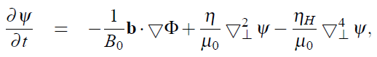
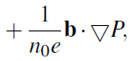
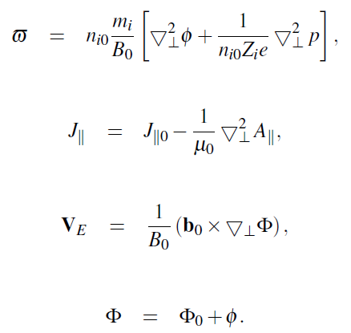
4-field peeling-Ballooning model with perturbed parallel velocity
With perturbed parallel velocity
Previous 3-field model
Hall effect term

Slide 8
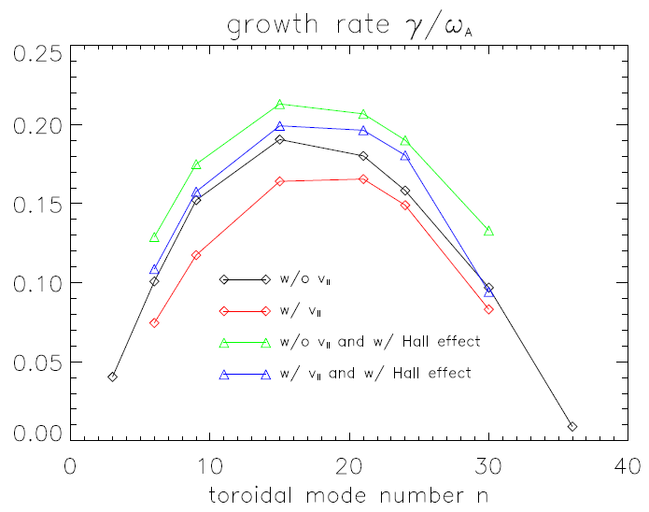
Perturbed parallel velocity can stabilize the peeling-ballooning mode
The parallel flow reduces the growth rate by around 20.0% .
The Hall effect increases the growth rate by 9.8%.
With parallel velocity, the Hall effect will increase the growth rate by 19.1%.

Slide 9
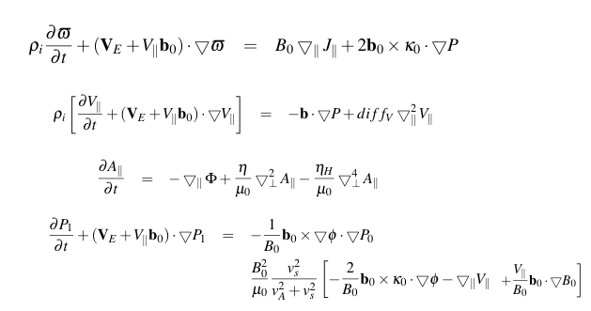
Parallel viscosity
The parallel viscosity acts as the diffusion term of parallel velocity.
Linear growth rate is independent of viscosity coefficient. For classic MHD model, diff_{v}=0.65 (R²_{0/}/T_{A}) m²/s.

Slide 10
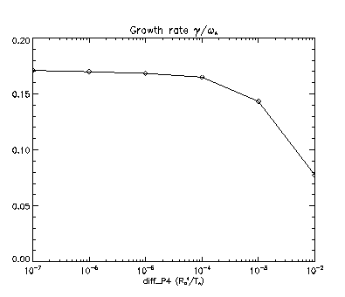
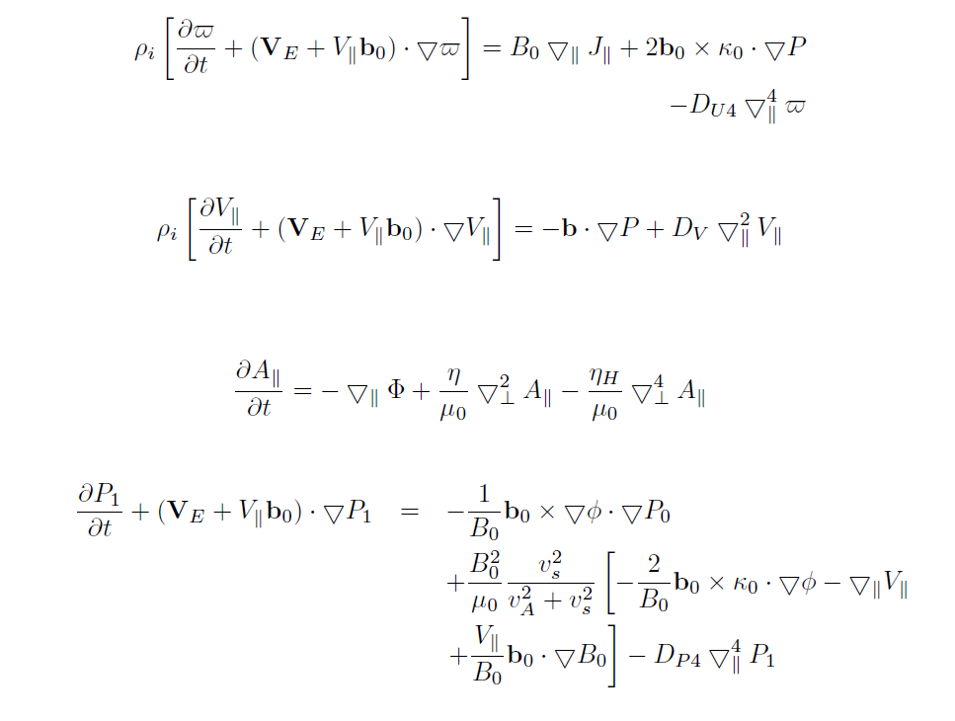
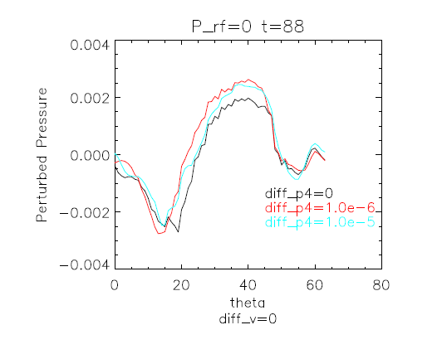
Hyper-diffusion
In order to smooth the zigzags of the profiles of variables to continue the calculation, we add the hyper-diffusion terms in the equations. We hope the hyper-diffusion of pressure and vorticity will not affect the growth rate and the ELM structure obviously, but can smooth the profiles effectively.

Slide 11
Outline
Background
4-field peeling-ballooning simulation with BOUT++
5-field simulation
Linear simulation on EAST
Comparison of numerical schemes in BOUT++
Summary

Slide 12
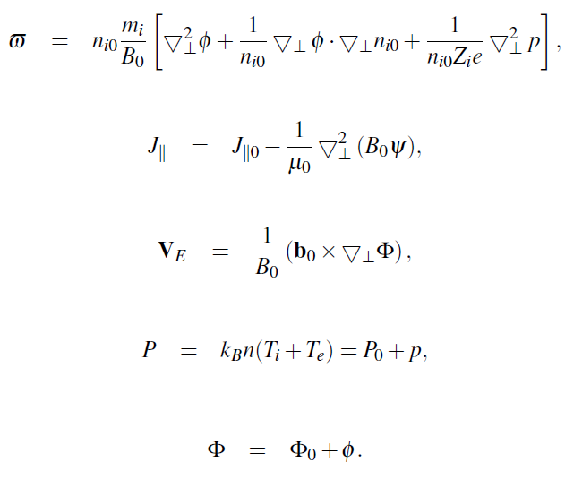
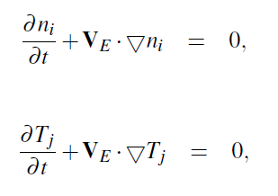
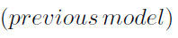
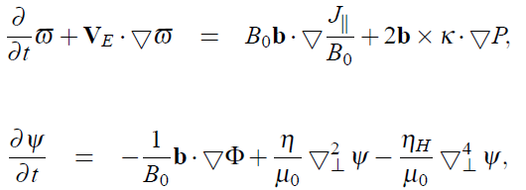
Theoretic Model for 5-Field in BOUT++
We evolve a set of nonlinear evolution equations for perturbations of the ion number density n_{i} , ion temperature T_{i}, electron temperature T_{e}, vorticity and magnetic flux ψ:

Slide 13
Effects of the diamagnetic drift in ELMs
Hastie* pointed out the dispersion relationship of the ballooning mode:
The growth rate of ideal MHD:
Neglect the electron part: −ω(ω−ω∗) = γ_{Ι}
Diamagnetic drift plays as the frequency threshold of the perturbation. Only the fluctuation with ω>ω∗/2 can grow.
* R. J. Hastie, J. J. Ramos, & F. Porcelli, Phys. Plasmas, 10, 4405 (2003).

Slide 14
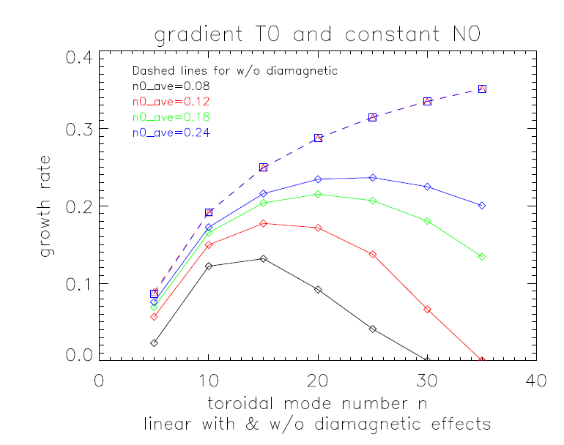
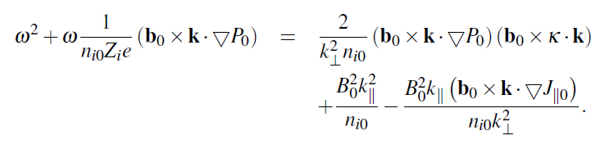
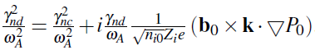
Diamagnetic stabilization on linear growth rate for spatial constant n₀
For Ideal MHD, spatial constant n₀ is equivalent to the previous 3-field results because the density terms do not appear in ideal MHD.
The dispersion relation is written as
γ_{nc} is the growth rate in ideal MHD and γ_{nd} is the growth rate with diamagnetic effects.
The diamagnetic drift term provides a real frequency and stabilizing effect. So the linear growth rate is proportional to n₀.
The units of n0_ave is 10²⁰

Slide 15
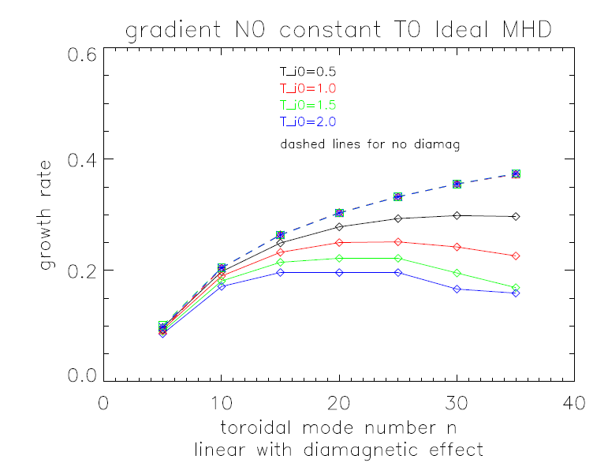
Diamagnetic stabilization on linear growth rate for spatial constant T₀
If T₀ is a spatial constant, then the cross term in the Laplace equation of vorticity generate novel effects.
For Ideal MHD, the cross term just plays as the oscillatory term, so for this case the linear growth rate should not changed a lot.
With diamagnetic effects, the linear growth rate is inversely proportional to T₀.
The units of T_{i0} is keV

Slide 16
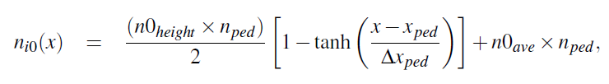
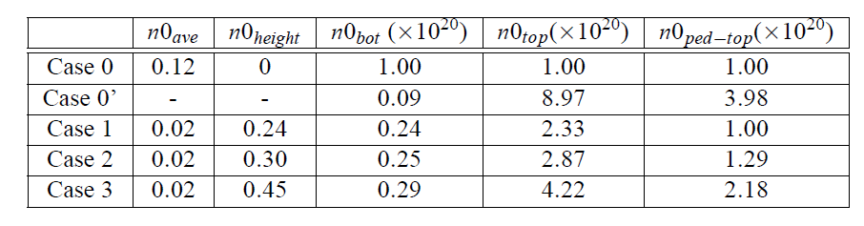
General cases for both radially varying n₀ and T₀
For more general situation, both the equilibrium temperature and density profiles are not constant in radial direction. Here we still apply the same pressure profile, but introduce the profile for ion density:
There are 5 density profiles are applied in this work:
Table 1. The parameters of five models of different equilibrium ion density profile.

Slide 17
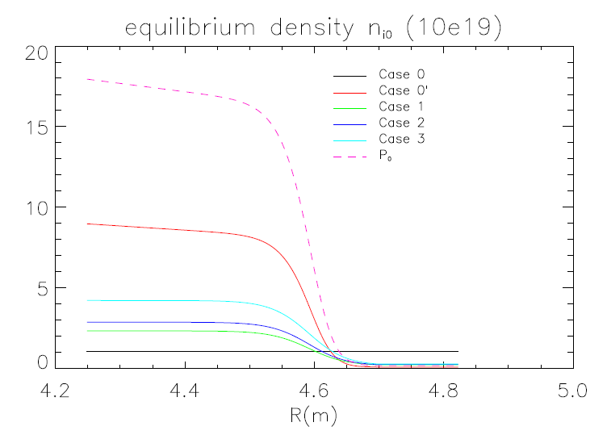
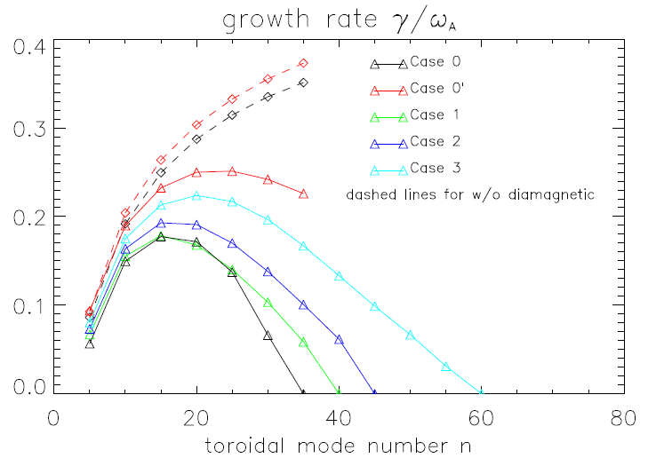
Diamagnetic stabilization on linear growth rate for both radially varying n₀ and T₀
The equilibrium density profiles for the cases in Table 1.
The linear growth rate for the cases in table 1. For Ideal MHD model, the linear growth rate of case 0’ is larger than case 0 by 6.2%. With diamagnetic effects, the percentage goes to 31.4% for n=15

Slide 18
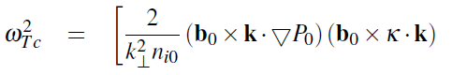
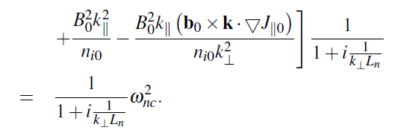
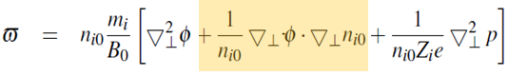
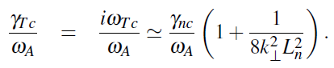
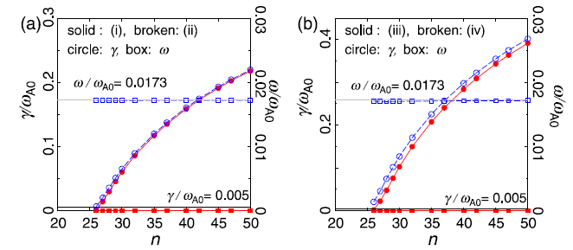
The cross term in vorticity can enlarge growth rate
For spatial constant T₀, the Fourier analysis will give the angular frequency as:
Then the linear growth rate is easily obtained as:
This equation shows the qualitatively same results as our simulations
Cross term
The similar results have been observed using MINERVA code*. (a) is for spatial constant n₀ and (b) for a radially varying n₀.
N. Aiba, M. Furukawa, M. Hirota & S. Tokuda, Nucl. Fusion 50 045002 (2010) .

Slide 19
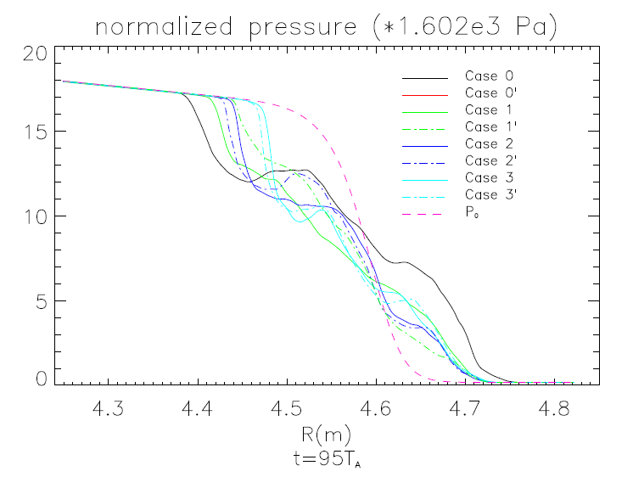
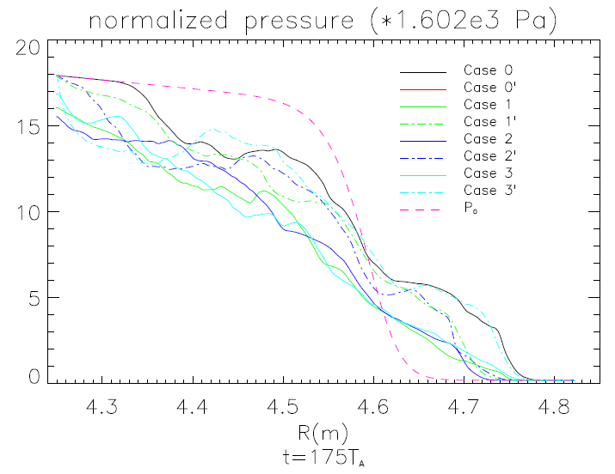
Radial pressure profile revolution during ELM crashes
Comparison of the radial pressure profiles on the outer mid-plane for the different cases for n=15.
Case 1, 2 and 3 use Neumann boundary in the core region and 1’, 2’ and 3’ apply Dirichlet boundary condition.
At the early nonlinear phase after ELM crashes, T=95T_{A}, the collapse keeps localized around the peak gradient region for all the cases.
At t=175T_{A}, the perturbations go into the core boundary except the constant n₀ case. This is because the cross term in the vorticity equation provides an additional drive on the radial direction.

Slide 20
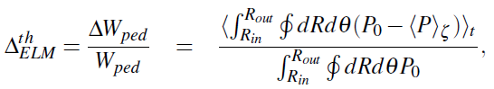
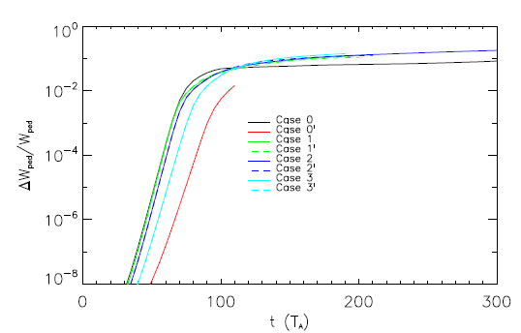
ELM size evolution after ELM crashes
In order to describe the nonlinear effects, we define the ELM size as
This figure shows that the ELM size is larger for a radially varying n₀ than for the spatial constant density case. This is related to the results on the previous page, which showed that the cross term in the vorticity equation provides an additional drive on the radial direction.

Slide 21
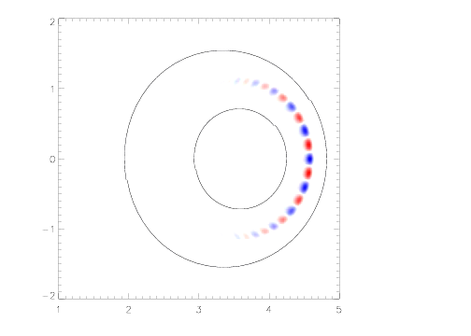
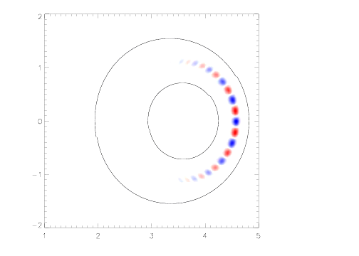
The poloidal distribution of density perturbation
Case 0, without density gradient.
Case 2, with density gradient.
With density gradient, the rotating direction will be different in linear phase.
In nonlinear phase the perturbation will go into the core region.

Slide 22
Outline
Background
4-field peeling-ballooning simulation with BOUT++
5-field simulation
Linear simulation on EAST
Comparison of numerical schemes in BOUT++
Summary
*

Slide 23
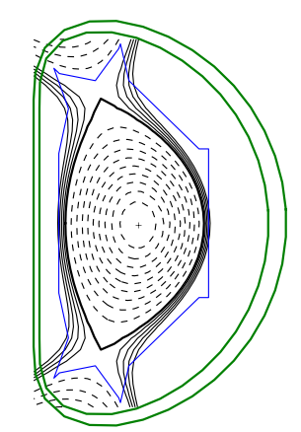
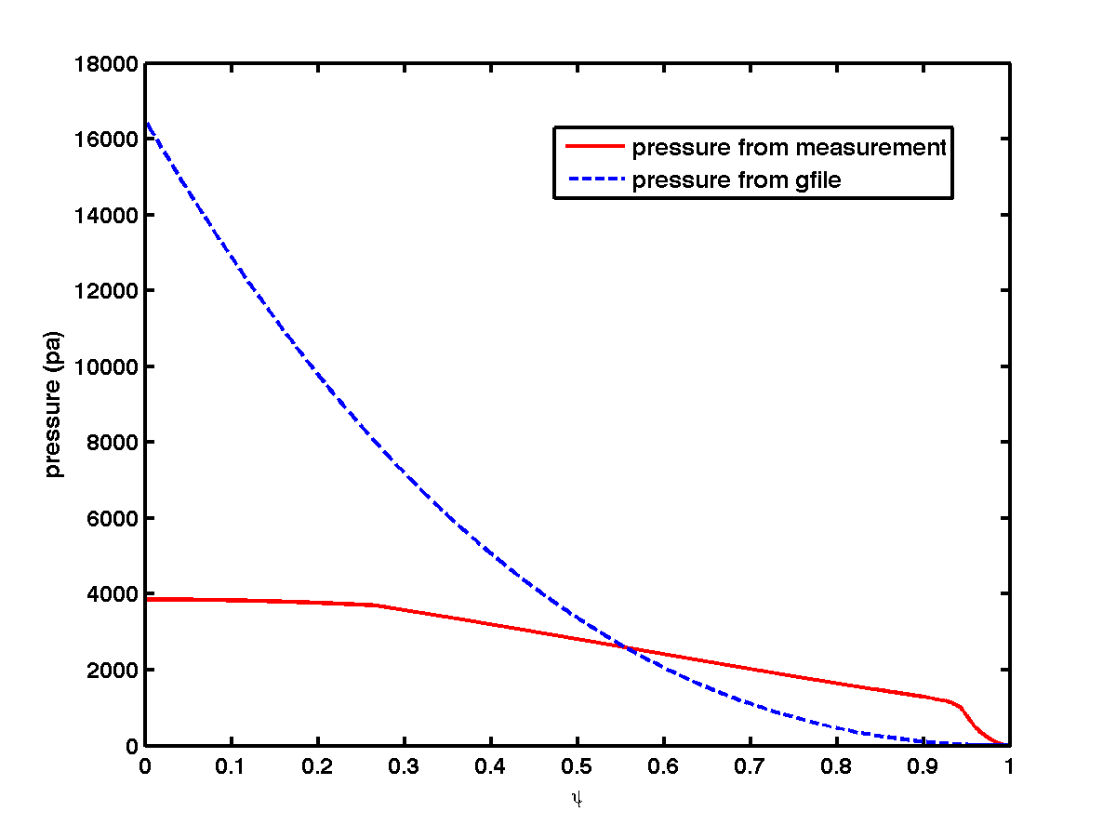
EAST data for the linear simulations with 3-field model*
Typical parameters of EAST:
Major radius R₀: 1.88m
Minor radius a: 0.43m
Toroidal Field B_{T}: 2.0T
Current I_{p}: 0.5MA
Safety factor q₉₅: 7.73
Electron temperature T_{e}: 5.11keV
Shot: #33068
The MHD equilibrium of EAST experiment is calculated by conventional EFIT. The pressure profile is not consistent with the measurement from experiment.
*Collaboration with Zixi Liu & Shaocheng Liu of EAST.

Slide 24
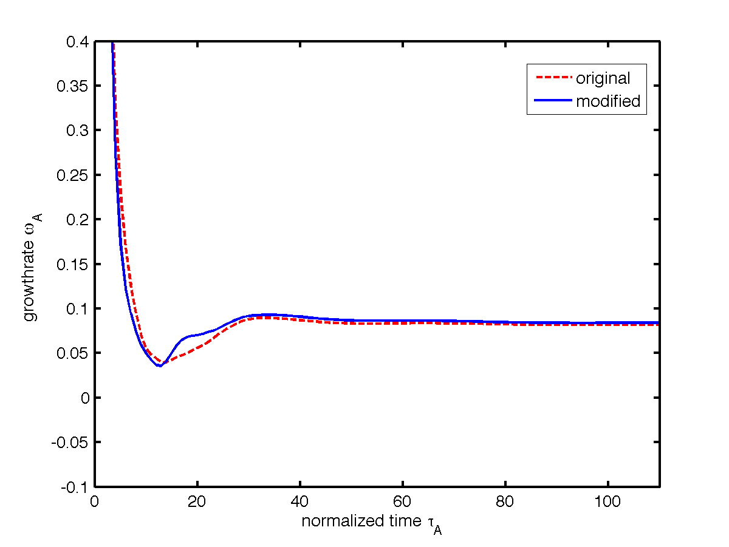
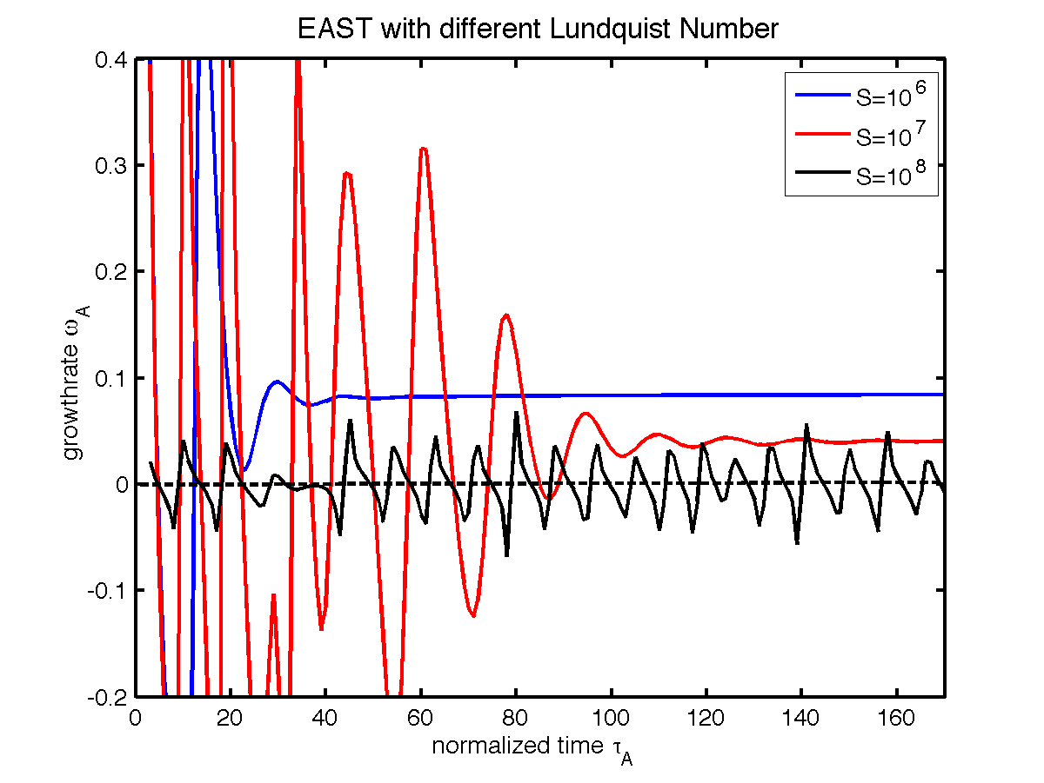
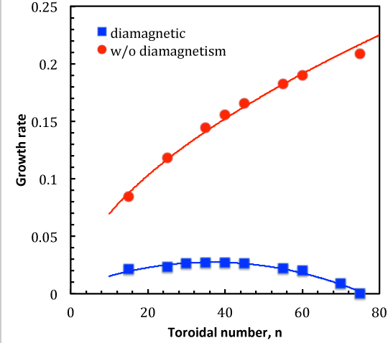
Linear simulations on EAST with 3-field model*
We use the magnetic geometry data in g-file and experimentally measured pressure and calculated current from the pressure.
To validate this method, the data of H-mode of C-mod is tested. We use the H-mode pressure and current to derive the similar results.
S=10⁸, ELMy free
S<=10⁷, ELMy
Diamagnetic effect is obvious in EAST.
*Collaboration with Zixi Liu & Shaocheng Liu.

Slide 25
Outline
Background
4-field peeling-ballooning simulation with BOUT++
5-field simulation
Linear simulation on EAST
Comparison of numerical schemes in BOUT++
Summary
*

Slide 26
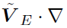


Comparison of differencing schemes for ELM simulations
For the purpose of broad application of BOUT++, various differencing schemes has been implemented. Here we compare the ELM simulations of 3-field model with several differencing methods to find the most robust scheme in ELM simulations.
The schemes used here are all for the nonlinear Poisson bracket. It means the ExB drift
( ) and magnetic flutter ( ). Because the simple methods of straight central or upwinding schemes for both terms will result in the code crashes in the early nonlinear phase, the special schemes are chosen:
3rd order WENO: Weighted Essentially Non-Oscillatory, a nonlinear adaptive procedure avoiding crossing discontinuities in the interpolation procedure as much as possible
Arakawa: original version is second order, keep the commutative property of Poisson bracket, the square vorticity conservation and kinetic energy conservation. In this work, we implement the 4th order Arakawa in the code for the first time.
CTU: Corner Transport Upwind, 1st order, takes into account the effect of information propagating across corners of zones in calculating the flux
1st and 4th order Upwind
4th order central

Slide 27
Linear growth rates for different schemes are converged to radial resolutions
Each the schemes obtain convergence.
Convergence for the different schemes is expected except for the 1st order upwinding for ExB drift, the reason is under investigation.
The convergent schemes show the differences less than 3%.
Linear growth rate vs. radial grid resolution. The schemes are labeled as X+Y:
X is the scheme for ExB drift.
Y is for magnetic flutter term.

Slide 28
Nonlinear: higher order ExB convection schemes yield saturate pressure
The nonlinear regime shows a more complicated convergence.
For high resolution, 3rd WENO + 4th order central or + upwinding shows good convergence with 3rd WENO + Arakawa. The difference is less than 3.5%. The full WENO scheme is larger by 15.0%
The schemes for ExB drift determine the saturate pressure more effectively than . Lower order schemes for EXB obtain the lower pressure.

Slide 29
Nonlinear: Saturate pressure for different resolution is grouped by the order of schemes
Poloidal resolution
Radial resolution

Slide 30
Nonlinear: ELM size with different resolutions is also grouped by the order of schemes
Poloidal resolution
Radial resolution

Slide 31

Nonlinear: k_{r} power spectra of perturbed pressure are converged for 5<k_{r}<80
All the schemes show the similar spectrum at medium k_{r}: 5<k_{r}<80.
For both resolutions, the 4th upwinding + Arakawa shows a larger spectrum at high k_{r}.
For the lower resolution at at high k_{r}, these WENO+ Arakawa and WENO+WENO get much larger spectra than the other schemes.
For the higher resolution case, WENO + Arakawa has the spectrum more close to full WENO. At high k_{r} end, both spectrums are damped and similar to other schemes.
Here k_{r} is the mode number

Slide 32
Nonlinear: k_{θ} power spectra of perturbed pressure shows consistency at high poloidal resolution
All the spectra shows consistency at poloidal direction except the first order schemes and 3rd WENO + 3rd WENO for 512x64x64 resolution.
Increasing the poloidal resolution, all the 3rd orders schemes show consistency.

Slide 33


Lower order + Arakawa scheme works well without hyper-resistivity for low radial resolutions
Lower grid resolution require larger hyper-resistivity: S_{H}=10¹¹ is necessary for 260x64 grid and S_{H}=1.43x10¹² for 1028x64 case, while S_{H}=1x10¹² for 516x64.
If we change the scheme for magnetic flutter from WENO to Arakawa, the simulation can work well for the resolutions below 1028 even without η_{H}. However, η_{H} is necessary for 1028x64.

Slide 34
Summary
4-field:
Perturbed parallel velocity will decrease the linear growth rate by 20.0%
5-field:
n₀ will not affect the linear growth rate in Ideal MHD model. With diamagnetic effects, the growth rate is inversely proportional to n₀.
For the same profile of P₀ and T₀ case, the cross term in vorticity enlarges the growth rate by 6.2% compared with spatial constant n₀ case in Ideal MHD. With diamagnetic effects, the percentage is 31.4% for n=15.
The density gradient will drive the perturbation into the core region and give a larger ELM size.
Schemes comparison:
For linear regime, most of the combinations of the schemes we tested in BOUT++ give the same results.
For nonlinear regime, the order of the schemes for ExB determines the results.
The Arakawa schemes in nonlinear magnetic flutter help the simulations to go through ELM crashes.
The k_{r} power spectra show that all the schemes are similar at medium k_{r}. The k_{θ} spectra shows that all the 3rd order schemes converge at high poloidal resolution.

